Slide 1
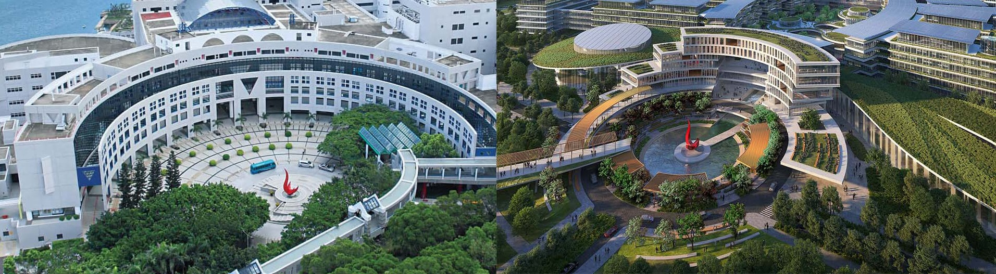
Vision Transformers
XIE WEIYAN (Vayne)
HKUST (GZ)
Supervisor: Prof. Nevin L. Zhang
2022.03.17

Slide 2
An image is worth 16x16 words: Transformers for image recognition at scale A Dosovitskiy et al., Google ICLR 2021(oral) Cited by 2845
Model Structures
2. Characteristics of ViT as compared with CNN
General Characteristics
- Domain Adaptation

Slide 3
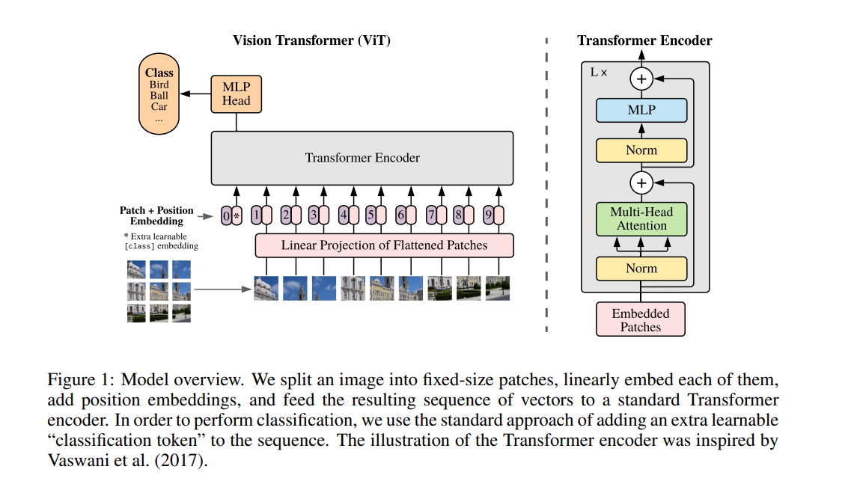
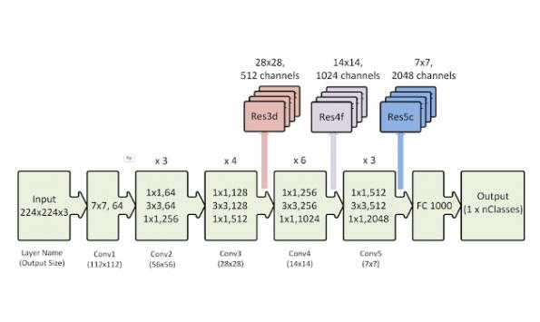
Deep-Narrow

Slide 4
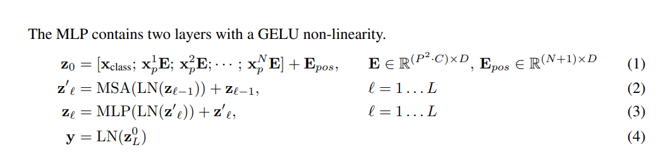
Structure of ViT

Slide 5
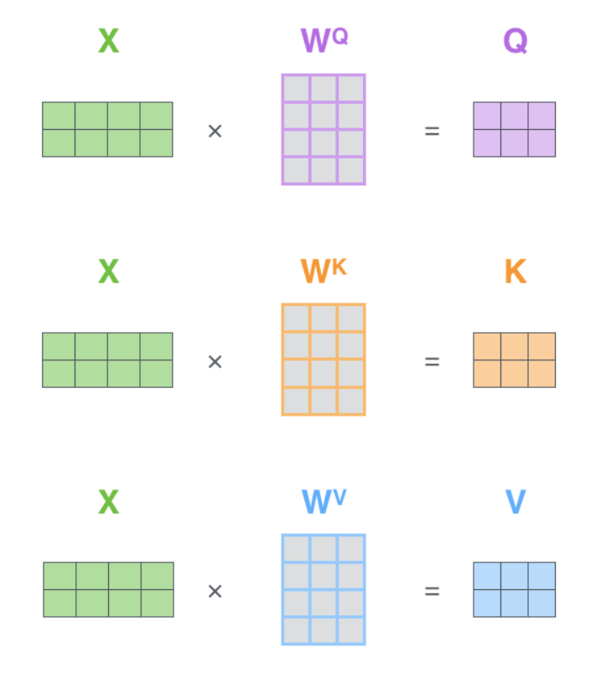
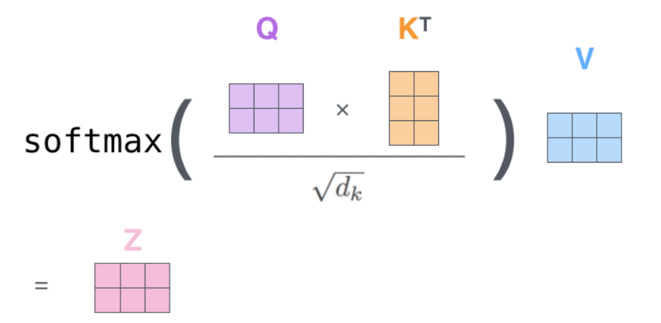
Self-Attention Mechanism

Slide 6
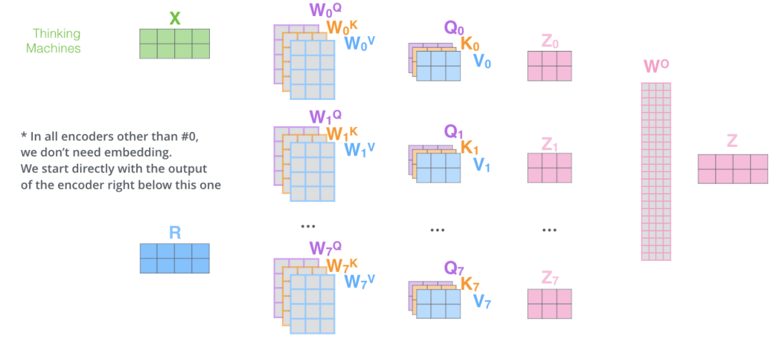
Multi-Head Self-Attention Mechanism

Slide 7
 | ViT | BiT | ResNet
JFT (300M) | 88.55 (ViT-H/14) 87.76 (ViT-L/16) 84.15 (ViT-B/16) | 87.54 (BiT-L:ResNet152x4) | 79.2 (ResNet 101)
I21K (13M) | 85.15 (ViT-L/16) 83.97 (ViT-B/16) 85.844 (ViT-L/16) 84.526 (ViT-B/16) | 84.5 (BiT-L:ResNet152x4)
I1K (1.3 M) | 76.53 (ViT-L/16) 77.91 (ViT-B/16) 83.4(DeiT-B/Distlled) 81.8 (DeiT-B) | 80.3 (BiT-L:ResNet152x4) | 76.4 (ResNet 101)
An image is worth 16x16 words: Transformers for image recognition at scale (Google, ICLR2021)
How to train your vit? data, augmentation, and regularization in vision transformers (Google)
Training data-efficient image transformers & distillation through attention (Facabook, ICML 2021)
“Transformers lack some of the inductive biases inherent to CNNs, such as translation equivariance and locality, and therefore do not generalize well when trained on insufficient amounts of data. ”

Slide 8
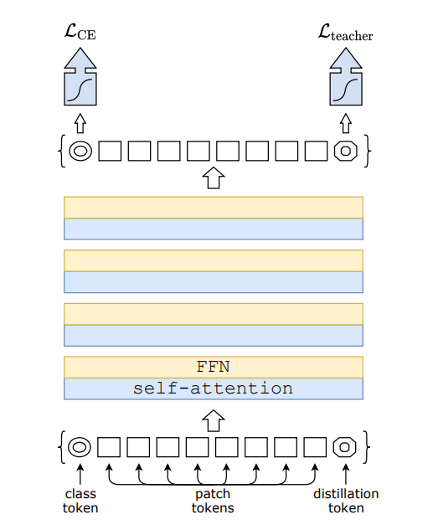
DeiT: Training data-efficient image transformers & distillation through attention
Touvron et al. Facebook AI, 2021

Slide 9
An image is worth 16x16 words: Transformers for image recognition at scale
Model Structures
2. Characteristics of ViT as compared with CNN
General Characteristics
Intriguing Properties of Vision Transformers (NIPS 2021)
Do Vision Transformers See Like Convolutional Neural Networks? (NIPS 2021)
How Do Vision Transformers Work (ICLR 2022)
- Domain Adaptation

Slide 10
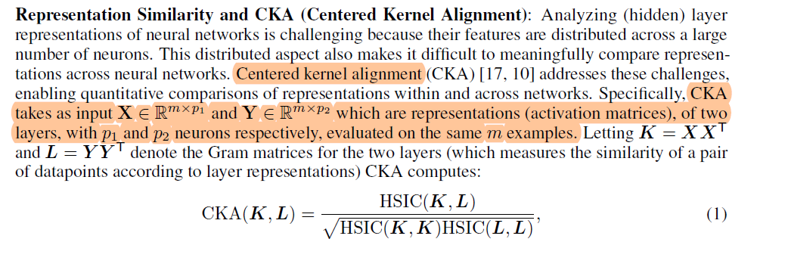
Layer Representations
Do Vision Transformers See Like Convolutional Neural Networks?
Raghu et al. (Google), NeurIPS 2021
Representation Similarity

Slide 11
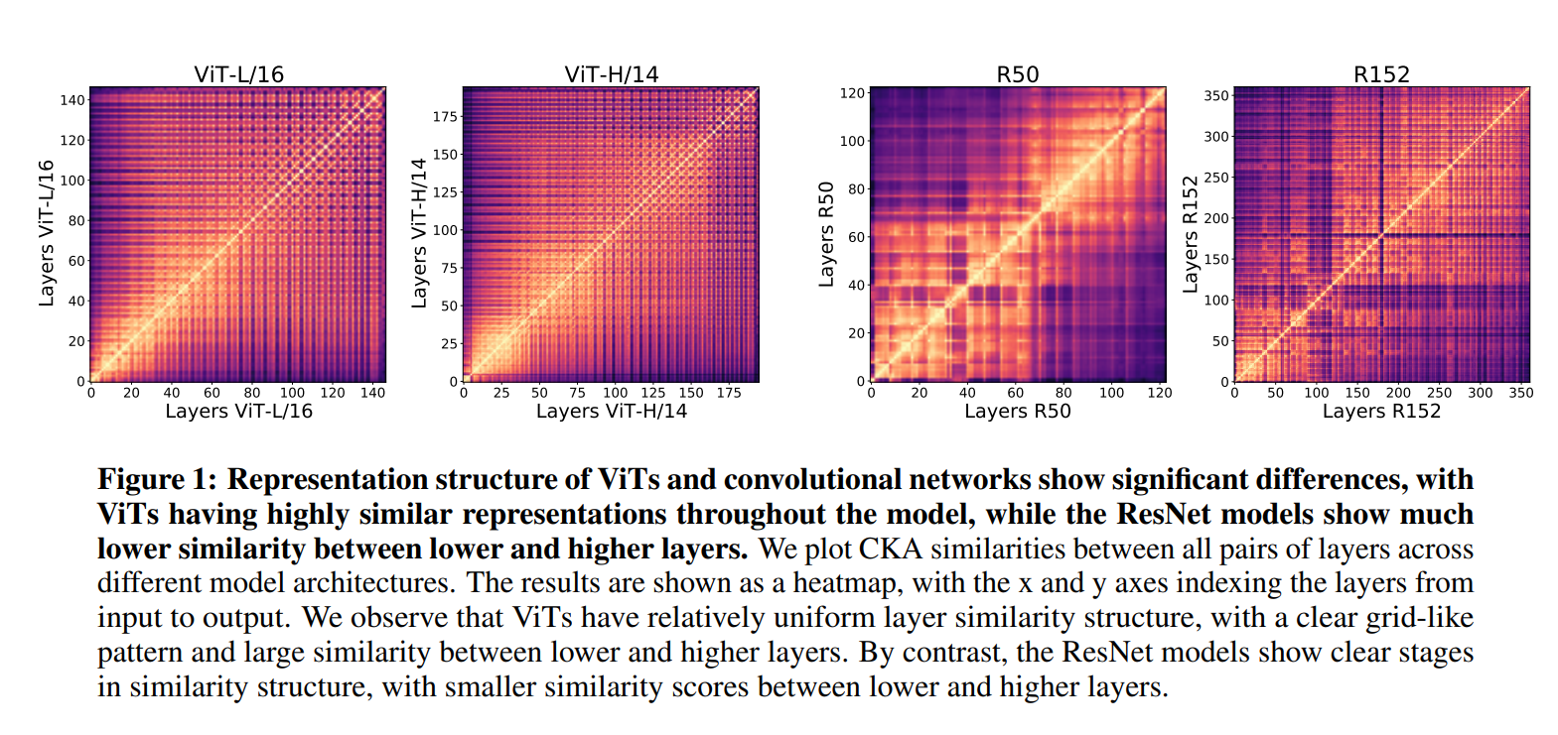
The layer representations in ViTs are more uniform than ResNet.
Do Vision Transformers See Like Convolutional Neural Networks? (NIPS 2021)

Slide 12
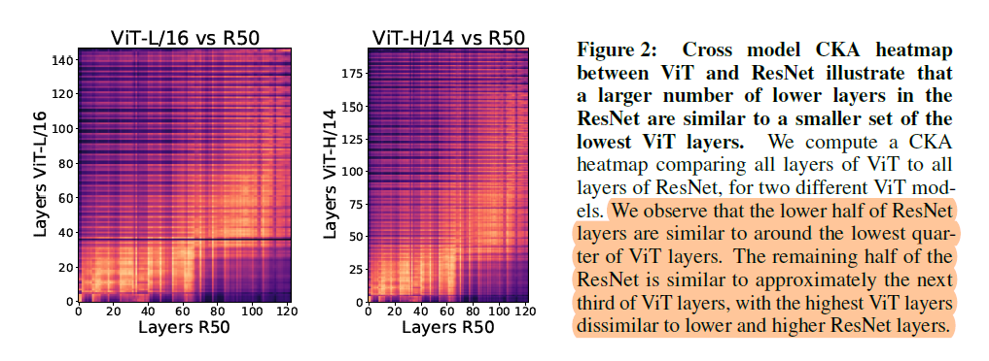
The top half of the ResNet is approximately similar to the next third of the ViT layers. → ResNet required more lower layers to compute similar representations to a smaller set of ViT lower layers.
The final third of ViT layers is less similar to all ResNet layers
Do Vision Transformers See Like Convolutional Neural Networks? (NIPS 2021)

Slide 13
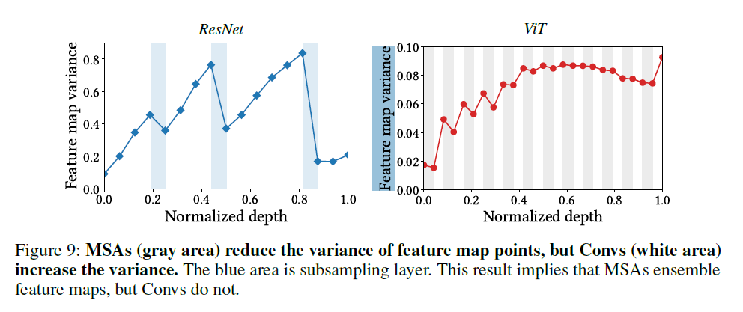
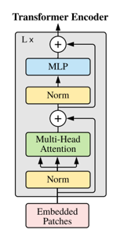
MLP
Convs
Subsamping
MSA
How Do Vision Transformers Work (ICLR 2022)

Slide 14
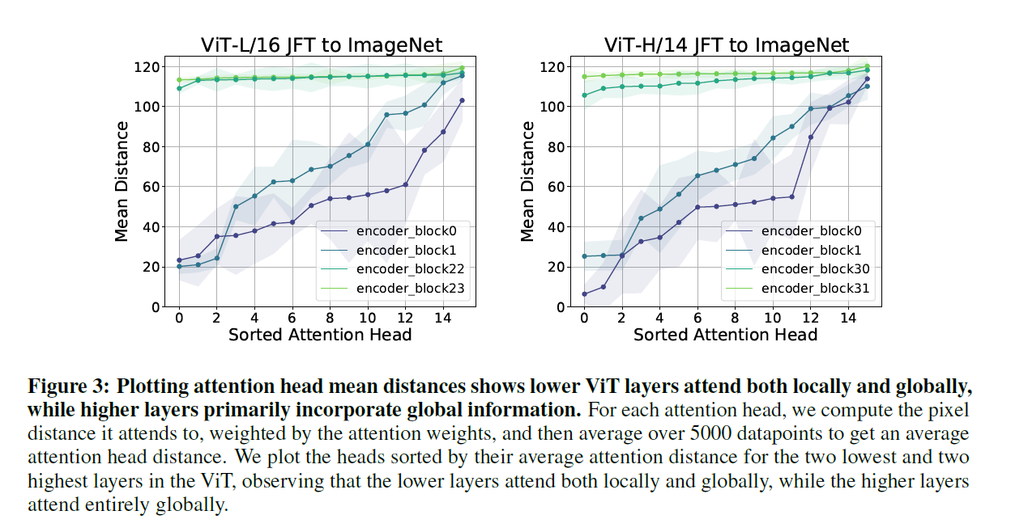
Local and Global Information in Layer Representations
This “attention distance” is analogous to receptive field size in CNNs.
Do Vision Transformers See Like Convolutional Neural Networks? (NIPS 2021)

Slide 15
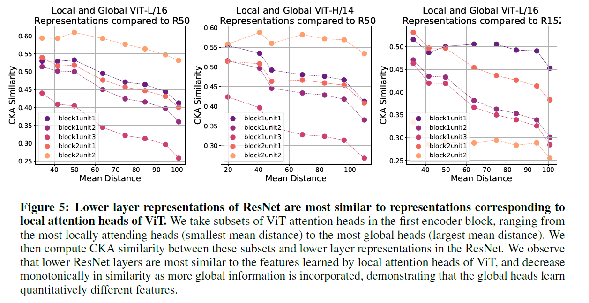
Local and Global Information in Layer Representations

Slide 16
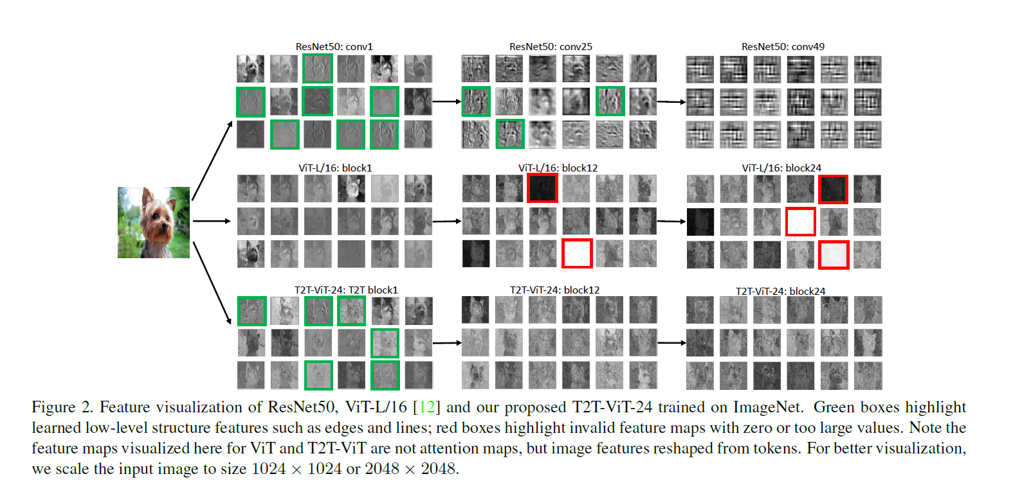
Tokens-to-Token ViT: Training Vision Transformers from Scratch on ImageNet (ICCV 2021)

Slide 17
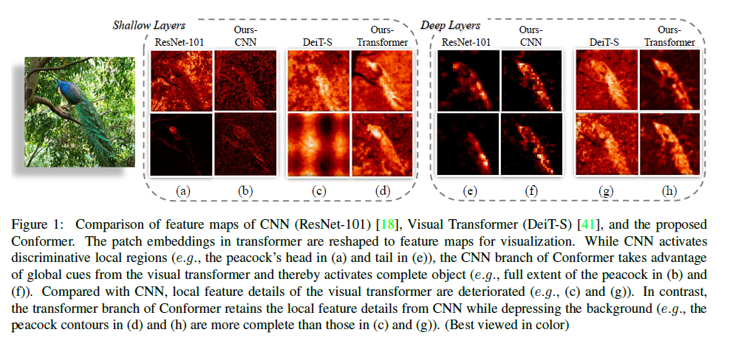
Conformer: Local Features Coupling Global Representations for Visual Recognition (ICCV 2021)

Slide 18
General Characteristics
Uniformity: cross-layer, inter-layer
Global → Global heads learn quantitatively different features
The ViTs can learn unique feature representation

Slide 19
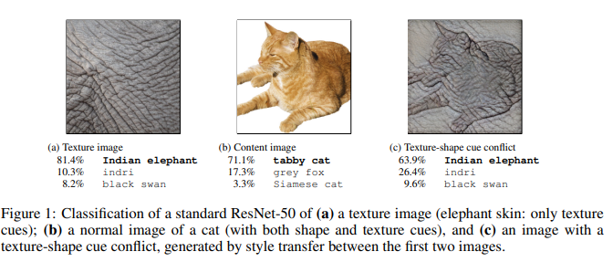
Shape vs. Texture
CNN
ImageNet-trained CNNs are biased towards texture; increasing shape bias improves accuracy and robustness

Slide 20
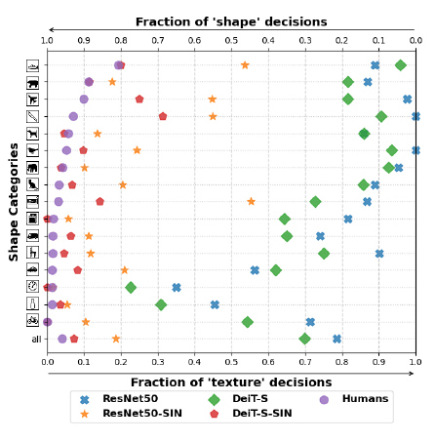
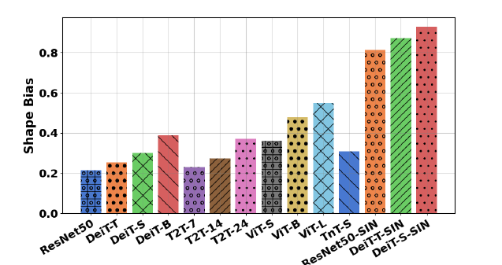
A stylized version of ImageNet named SIN
Intriguing Properties of Vision Transformers (NIPS 2021)

Slide 21
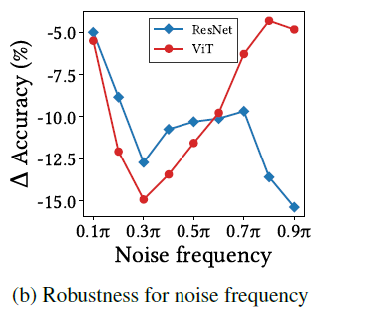
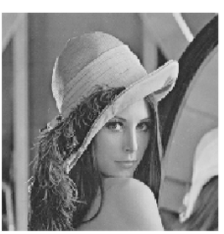
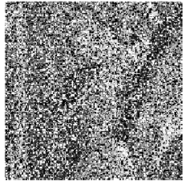
Shape vs. Texture
How Do Vision Transformers Work (ICLR 2022)

Slide 22
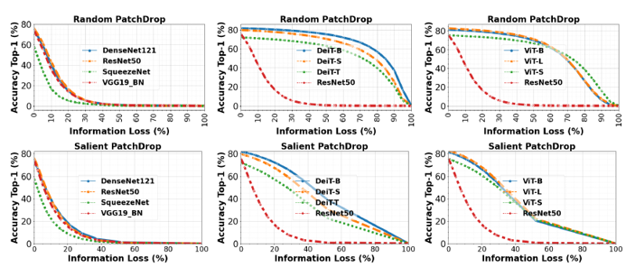
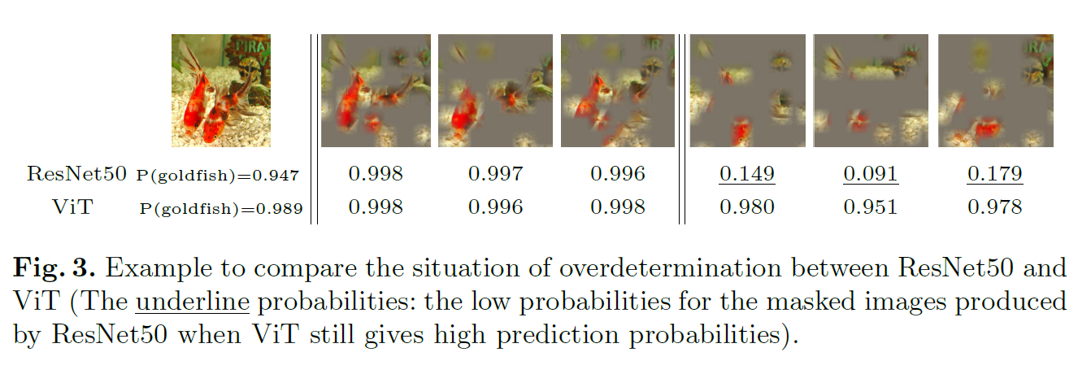
Robustness against object occlusion in images
Intriguing Properties of Vision Transformers (NIPS 2021)

Slide 23
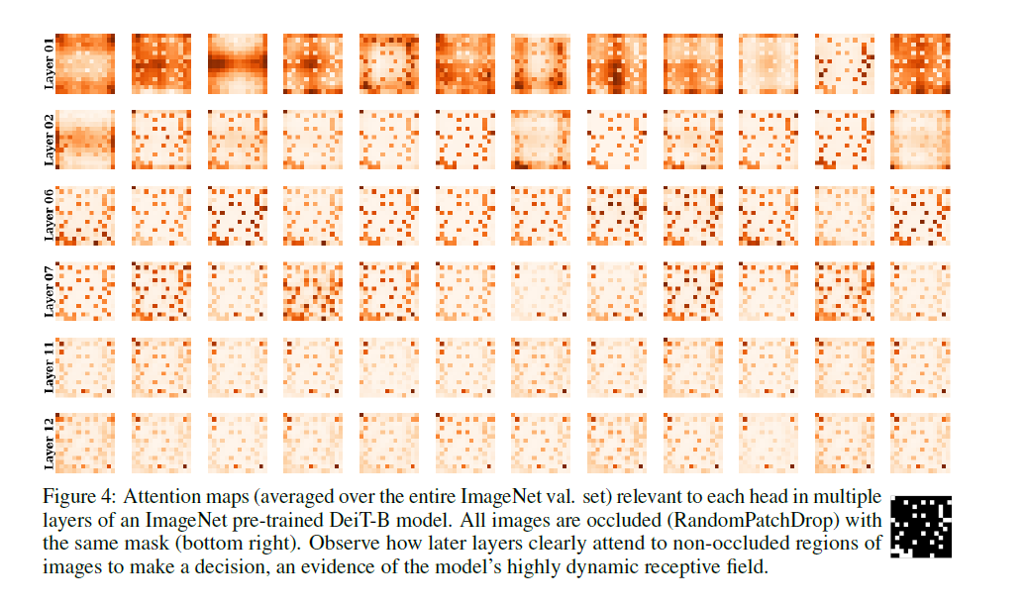
Intriguing Properties of Vision Transformers (NIPS 2021)

Slide 24
An image is worth 16x16 words: Transformers for image recognition at scale
Model Structures
2. Characteristics of ViT as compared with CNN
General Characteristics
Domain Adaptation
Vision Transformers are Robust Learners (AAAI 2022)
Understanding Robustness of Transformers for Image Classification (ICCV 2021)
Are Transformers More Robust Than CNNs ? (NIPS 2021)

Slide 25
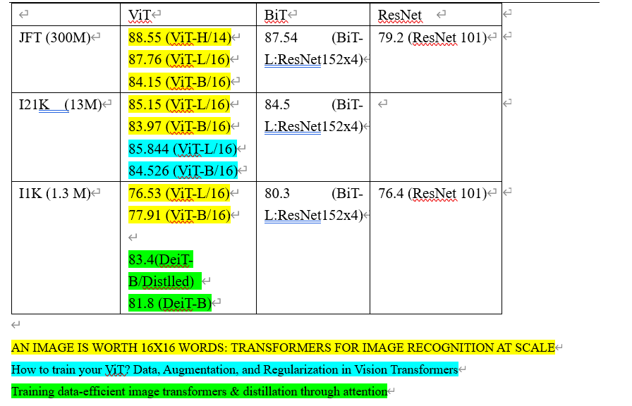
ResNet50
BiT
ViT
Since ViT and BiT share similar pre-training strategies (such as using larger datasets like ImageNet-21k (Deng et al. 2009) and JFT-300 (Sun et al. 2017), longer pre-training schedules, and so on) they are excellent candidates for our comparison purposes.

Slide 26
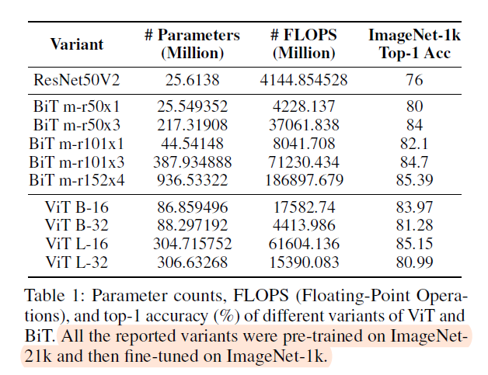
Vision Transformers are Robust Learners (AAAI 2022)

Slide 27
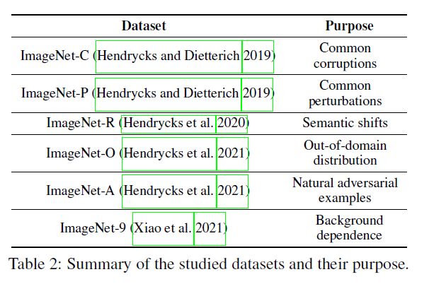

Slide 28
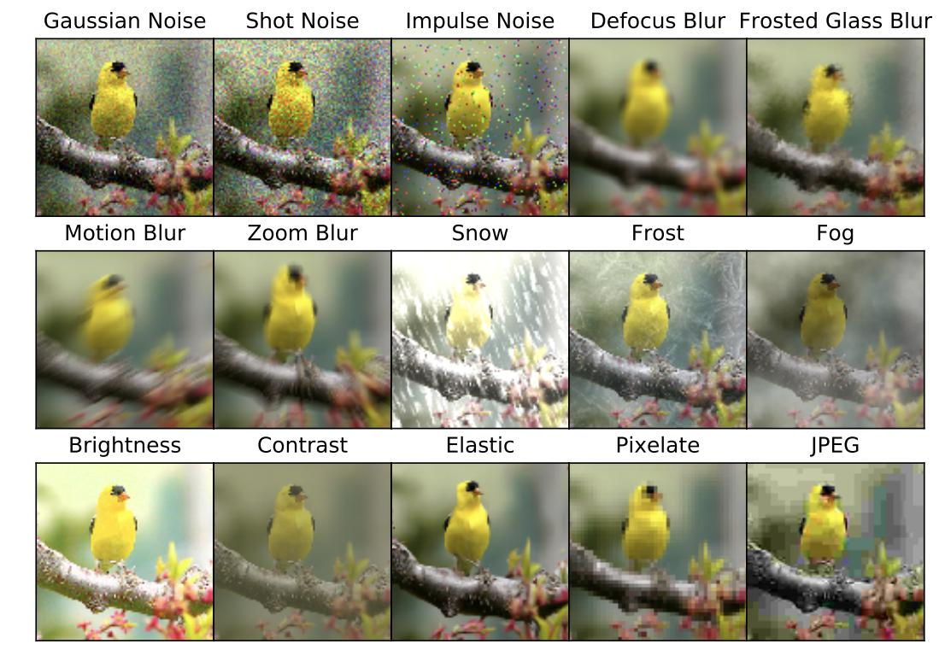
ImageNet-C

Slide 29
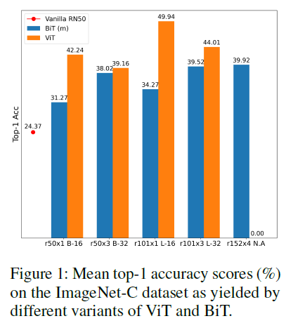
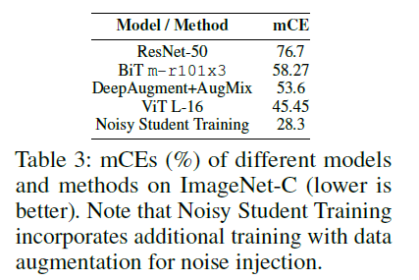
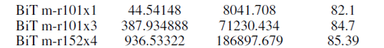
ImageNet-C
We consider all the 19 corruptions at their highest severity level (5) and report the mean top-1 accuracy in Figure 1 as yielded by the variants of ViT and BiT.
In (Hendrycks and Dietterich 2019), mean corruption error (mCE) is used to quantify the robustness factors of a model on ImageNet-C. Specifically, the top-1 error rate is computed for each of the different corruption (c) types (1 c 15) and for each of the severity (s) levels (1 s 5).
ResNet50
EfficientNet
Notes:
The Many Faces of Robustness: A Critical Analysis of Out-of-Distribution Generalization
Self-training with Noisy Student improves ImageNet classification

Slide 30
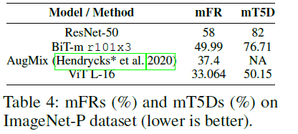
ImageNet-P
mean flip rate (mFR) and mean top-5 distance (mT5D) are the standard metrics to evaluate a model’s robustness under these perturbations
Noisy Student Training (EfficientNet) mFR: 12.2
Vision Transformers are Robust Learners (AAAI 2022)

Slide 31
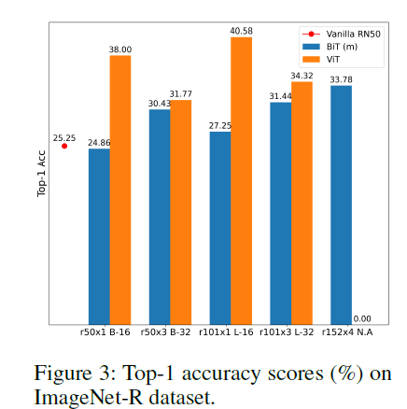
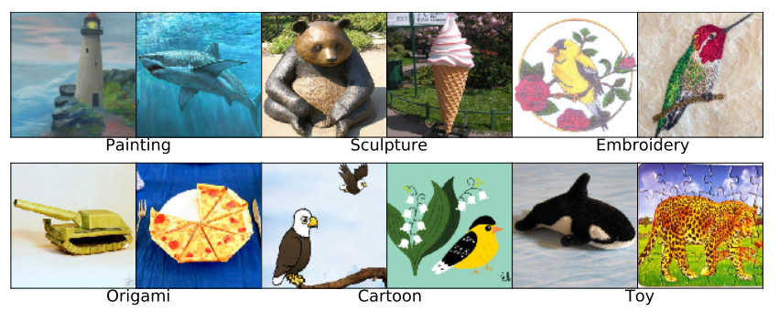
ImageNet-R
ResNet50+ DeepAugment + AugMix: 46.78
Vision Transformers are Robust Learners (AAAI 2022)

Slide 32
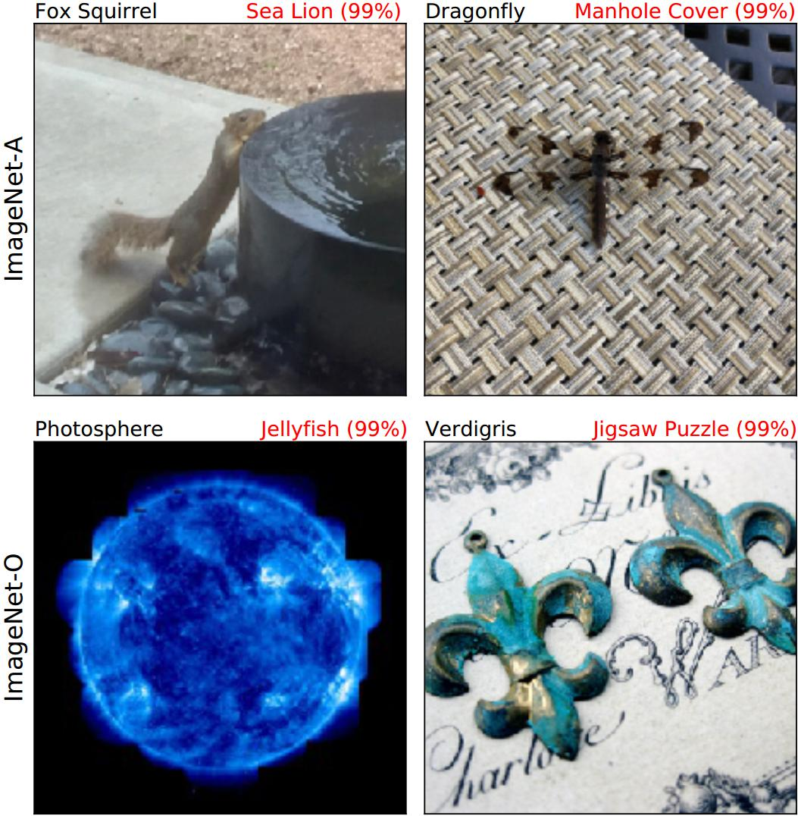
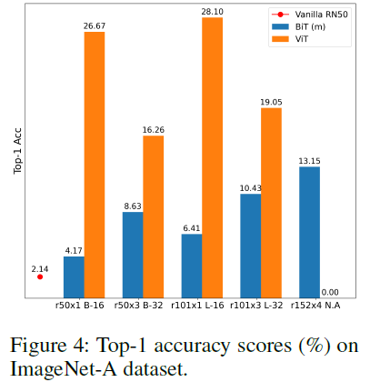
ImageNet-A
ImageNet-A (Hendrycks et al. 2021) is comprised of natural images that cause misclassifications due to reasons such as multiple objects associated with single discrete categories.
Noisy Student Training (EfficientNet): 83.7%

Slide 33
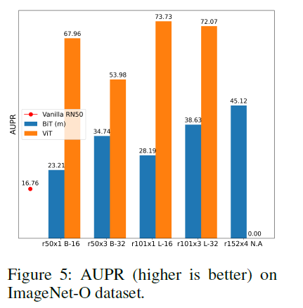
ImageNet-O
ImageNet-O (Hendrycks et al. 2021) consists of images that belong to different classes not seen by a model during its training and are considered as anomalies. For these images, a robust model is expected to output low confidence scores. We follow the same evaluation approach of using area under the precision-recall curve (AUPR) as (Hendrycks et al. 2021) for this dataset.

Slide 34
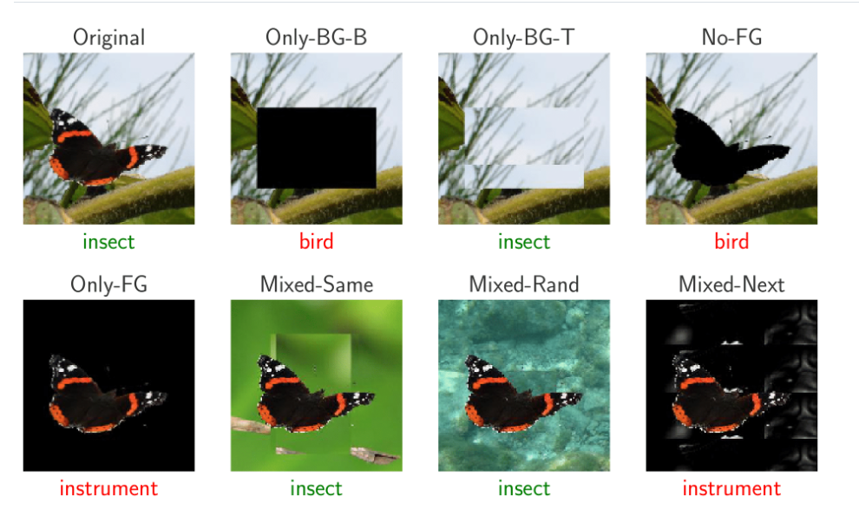
ImageNet-9

Slide 35
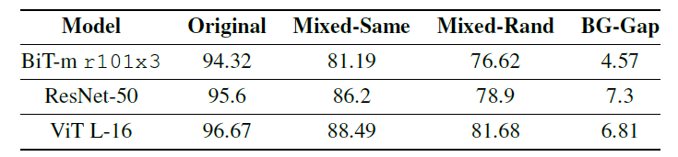
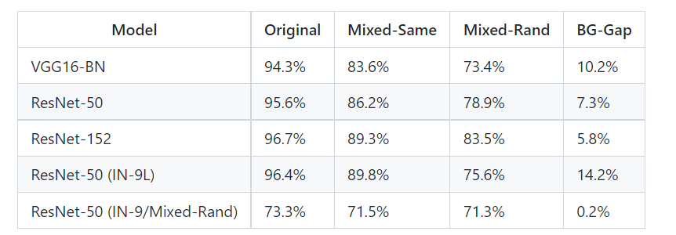
ImageNet-9
Vision Transformers are Robust Learners (AAAI 2022)
Noise or Signal: The Role of Image Backgrounds in Object Recognition (ICLR2020)
The BG-Gap, or the difference between Mixed-Same and Mixed-Rand, measures the impact of background correlations in the presence of correct-labeled foregrounds.

Slide 36
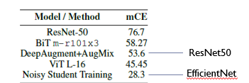
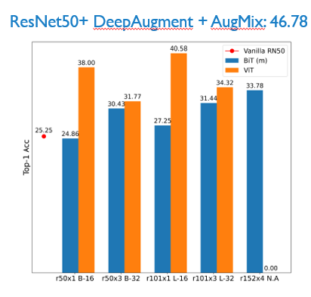
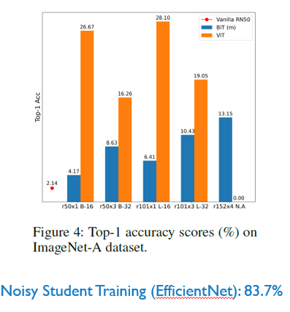
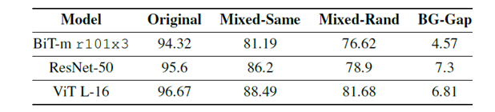
Noisy Student Training (EfficientNet) mFR: 12.2

Slide 37
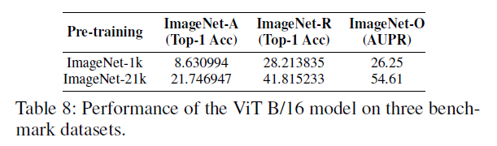
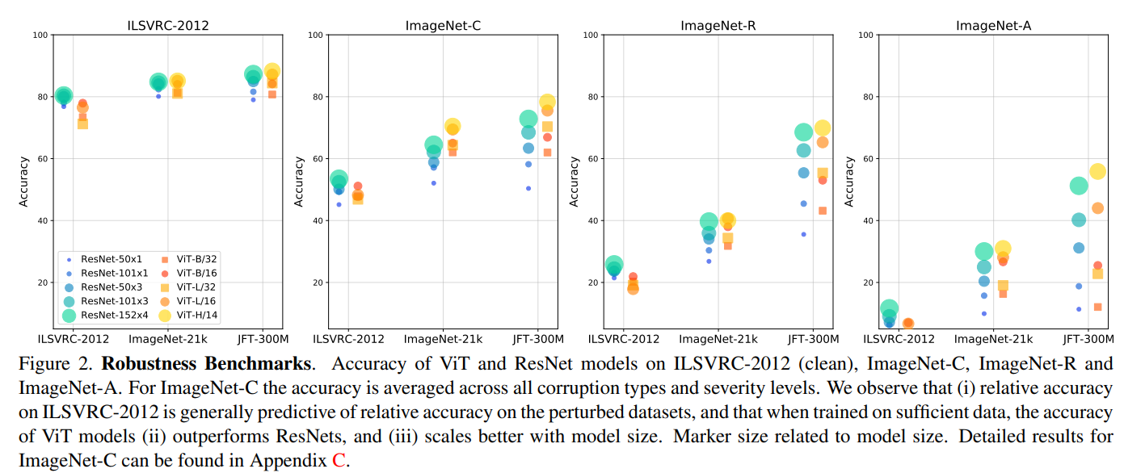
Role of Pre-training
Vision Transformers are Robust Learners (AAAI 2022)
Understanding Robustness of Transformers for Image Classification (ICCV 2021)

Slide 38
ViT vs. CNN
ViT + CNN

Slide 39
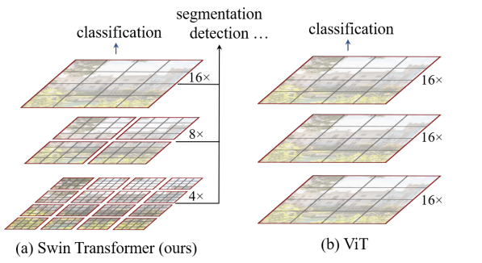
ViT
ResNet50
感受野（Receptive-Field)
Swin Transformers

Slide 40
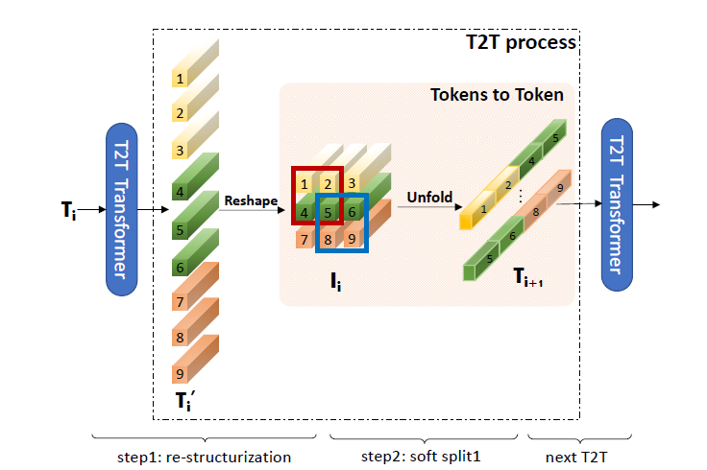

ResNet50
Deep-Narrow
T2T ViT

Slide 41


